Slide 1

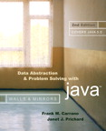
Chapter 10
Algorithm Efficiency and Sorting

Slide 2

Measuring the Efficiency of Algorithms
Analysis of algorithms
  Provides tools for contrasting the efficiency of different methods of solution
A comparison of algorithms
  Should focus of significant differences in efficiency
  Should not consider reductions in computing costs due to clever coding tricks

Slide 3
Measuring the Efficiency of Algorithms
Three difficulties with comparing programs instead of algorithms
  How are the algorithms coded?
  What computer should you use?
  What data should the programs use?
Algorithm analysis should be independent of
  Specific implementations
  Computers
  Data

Slide 4
The Execution Time of Algorithms
Counting an algorithm's operations is a way to access its efficiency
  An algorithm’s execution time is related to the number of operations it requires
  Examples
    Traversal of a linked list
    The Towers of Hanoi
    Nested Loops

Slide 5
Algorithm Growth Rates
An algorithm’s time requirements can be measured as a function of the problem size
An algorithm’s growth rate
  Enables the comparison of one algorithm with another
  Examples
    Algorithm A requires time proportional to n²
    Algorithm B requires time proportional to n
Algorithm efficiency is typically a concern for large problems only

Slide 6
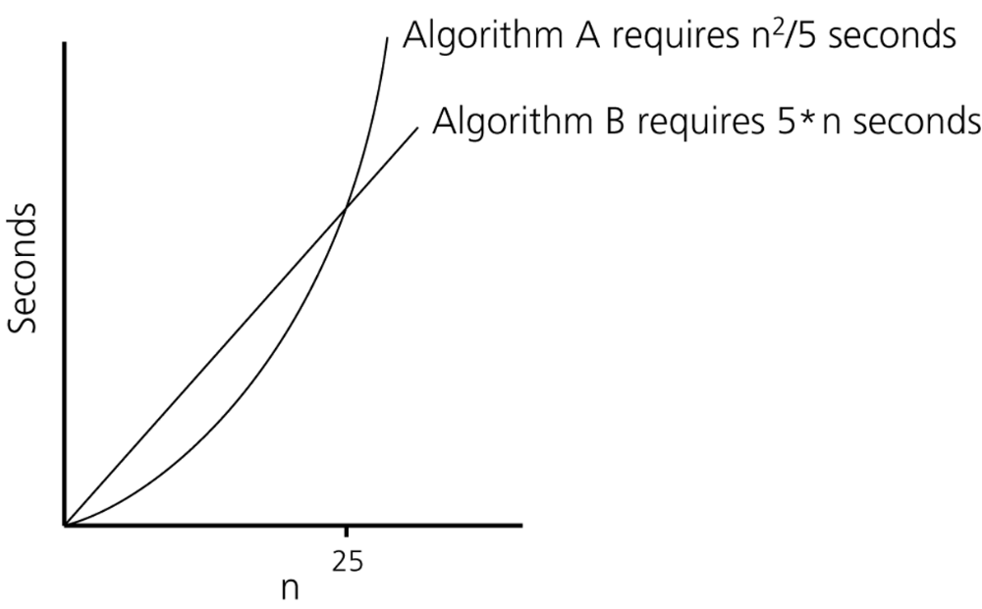
Algorithm Growth Rates
Figure 10-1
Time requirements as a function of the problem size n

Slide 7
Order-of-Magnitude Analysis and Big O Notation
Definition of the order of an algorithm
  Algorithm A is order f(n) – denoted O(f(n)) – if constants k and n₀ exist such that A requires no more than k * f(n) time units to solve a problem of size n ≥ n₀
Growth-rate function
  A mathematical function used to specify an algorithm’s order in terms of the size of the problem
Big O notation
  A notation that uses the capital letter O to specify an algorithm’s order
  Example: O(f(n))

Slide 8
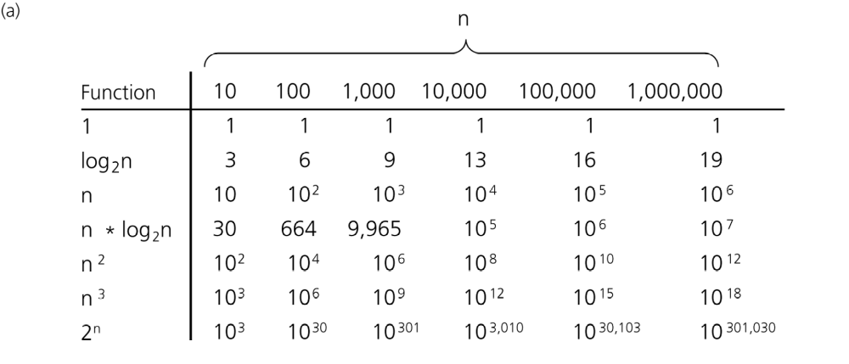
Order-of-Magnitude Analysis and Big O Notation
Figure 10-3a
A comparison of growth-rate functions: a) in tabular form

Slide 9
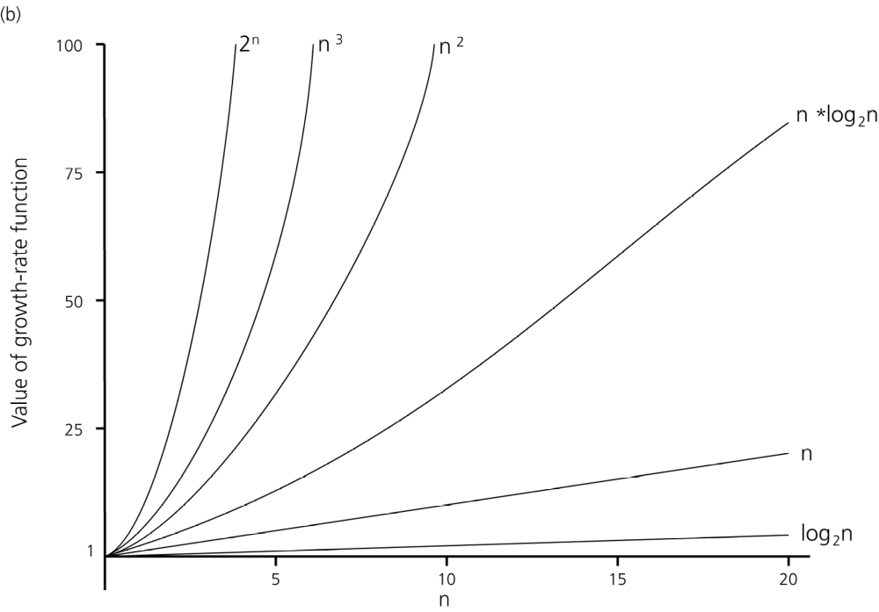
Order-of-Magnitude Analysis and Big O Notation
Figure 10-3b
A comparison of growth-rate functions: b) in graphical form

Slide 10
Order-of-Magnitude Analysis and Big O Notation
Order of growth of some common functions
  O(1) < O(log₂n) < O(n) < O(n * log₂n) < O(n²) < O(n³) < O(2^{n})
Properties of growth-rate functions
  You can ignore low-order terms
  You can ignore a multiplicative constant in the high-order term
  O(f(n)) + O(g(n)) = O(f(n) + g(n))

Slide 11
Order-of-Magnitude Analysis and Big O Notation
Worst-case and average-case analyses
  An algorithm can require different times to solve different problems of the same size
    Worst-case analysis
      A determination of the maximum amount of time that an algorithm requires to solve problems of size n
    Average-case analysis
      A determination of the average amount of time that an algorithm requires to solve problems of size n

Slide 12
Keeping Your Perspective
Throughout the course of an analysis, keep in mind that you are interested only in significant differences in efficiency
When choosing an ADT’s implementation, consider how frequently particular ADT operations occur in a given application
Some seldom-used but critical operations must be efficient

Slide 13
Keeping Your Perspective
If the problem size is always small, you can probably ignore an algorithm’s efficiency
Weigh the trade-offs between an algorithm’s time requirements and its memory requirements
Compare algorithms for both style and efficiency
Order-of-magnitude analysis focuses on large problems

Slide 14
The Efficiency of Searching Algorithms
Sequential search
  Strategy
    Look at each item in the data collection in turn, beginning with the first one
    Stop when
      You find the desired item
      You reach the end of the data collection

Slide 15
The Efficiency of Searching Algorithms
Sequential search
  Efficiency
    Worst case: O(n)
    Average case: O(n)
    Best case: O(1)

Slide 16
The Efficiency of Searching Algorithms
Binary search
  Strategy
    To search a sorted array for a particular item
      Repeatedly divide the array in half
      Determine which half the item must be in, if it is indeed present, and discard the other half
  Efficiency
    Worst case: O(log₂n)
For large arrays, the binary search has an enormous advantage over a sequential search

Slide 17
Sorting Algorithms and Their Efficiency
Sorting
  A process that organizes a collection of data into either ascending or descending order
Categories of sorting algorithms
  An internal sort
    Requires that the collection of data fit entirely in the computer’s main memory
  An external sort
    The collection of data will not fit in the computer’s main memory all at once but must reside in secondary storage

Slide 18
Sorting Algorithms and Their Efficiency
Data items to be sorted can be
  Integers
  Character strings
  Objects
Sort key
  The part of a record that determines the sorted order of the entire record within a collection of records

Slide 19
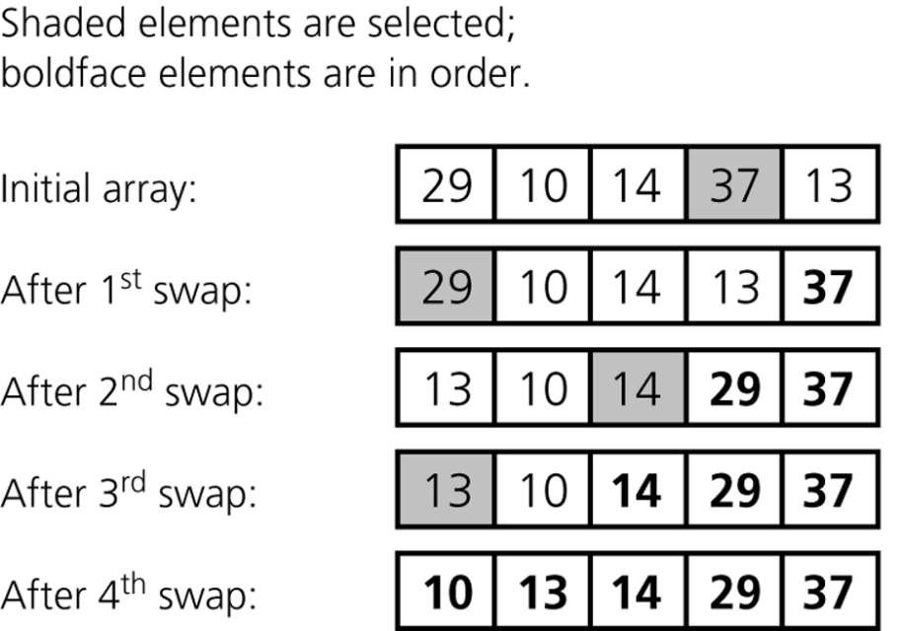
Selection Sort
Selection sort
  Strategy
    Select the largest item and put it in its correct place
    Select the next largest item and put it in its correct place, etc.
Figure 10-4
A selection sort of an array of five integers

Slide 20
Selection Sort
Analysis
  Selection sort is O(n²)
Advantage of selection sort
  It does not depend on the initial arrangement of the data
Disadvantage of selection sort
  It is only appropriate for small n

Slide 21
Please open file carrano_ppt10_B.ppt
to continue viewing chapter 10.

